Slide 1
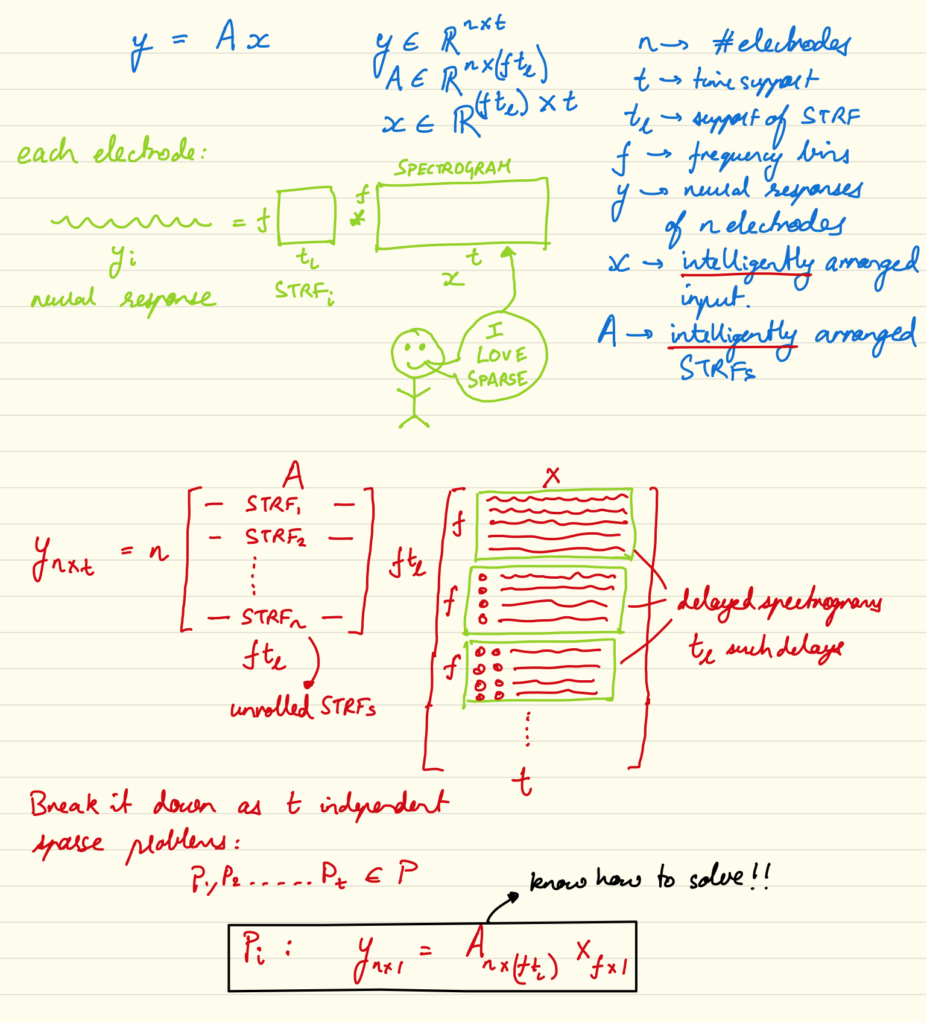
Recovery of Heard Speech Spectrograms
Vinay Raghavan and Aditya Sinha
Goal: Reconstruct auditory spectrogram of heard speech from neural data and spectro-temporal receptive fields
Approach: Refactor convolution as matrix multiplication and perform recovery of sparse spectrograms
Bonus: Apply dictionary to auditory spectrogram and instead learn sparse dictionary representation
Outcome: Reconstruct spectrogram with slow and intermediate temporal fluctuations that can be distinguished from other speech signals

